Slide 1

WIN Prediction Analytics
CAP STONE DATA SCIENCE PRODEGREE PROJECT – KPMG (KNOWLEDGE PARTNER)

Slide 2
ABSTRACT:
In this project, we will analyze and predict the win possibilities of deals/projects for an IT consulting company and see how the possibility of winning a deal is impacted by other variables. This will enable the IT consulting company to manage the effort required to win a deal to meet the growth targets.
PROJECT OUTLOOK:
IT firms compete for winning large deals by designing and proposing solutions to their clients. Even a marginal improvement in the win rate can result into substantial revenue addition for IT firm .
By predicting the probability of winning a deal, the management teams can prioritize the pipeline of opportunities to staff.
OBJECTIVE:
Predictive Analytics - Build a ML model to predict the probability of win/loss for bidding activities for a potential client.
Prescriptive Analytics – Identify variable/s that are most likely to help in converting an opportunity into a win.
Recommending top 5 Head-Bid Manager.
For every false prediction calculate the loss which the company will face.

Slide 3
Overview of the data:
Column Name | Description
Client Category | Industry in which the client works
Solution Type | The solution group the client requires
Deal Date | The date the opportunity was created
Sector | The sector for which the solution is to be provided
Location | Client location
VP Name | Sr. Manager or VP who is dealing with the client
Manager Name | Manager of the team working on the project
Deal Cost | The initial cost of the deal
Deal Status Code | Final status of the deal(won/lost)

Slide 4
Data Exploration :
Response variable : Deal Status Code- Won or Loss
Independent variable : Other 8 variables.
No of observation : 10061
Sample data is from the year 2011 to 2019
Variable type : Data is categorical and most of the variables are in nominal scale except the deal cost (numeric)
Unique values under each category :
Variables
Client Category | 40
Solution Type | 67
Deal Date | 2555
Sector | 25
Location | 13
VP Name | 43
Manager Name | 278
Deal Cost | 1468
Deal Status Code | 2

Slide 5
Data Pre-processing
Checking for Missing values:
Missing values are considered to be the first barrier in predictive modeling.
The choice of method to impute missing values, largely influences the model’s predictive ability.
Deletion is the default method used to impute missing values. But, it not as advisable as it may leads to information loss.
Here it is found that the missing are present in the variables Client category and Deal cost, which may impact the further prediction in the model.

Slide 6
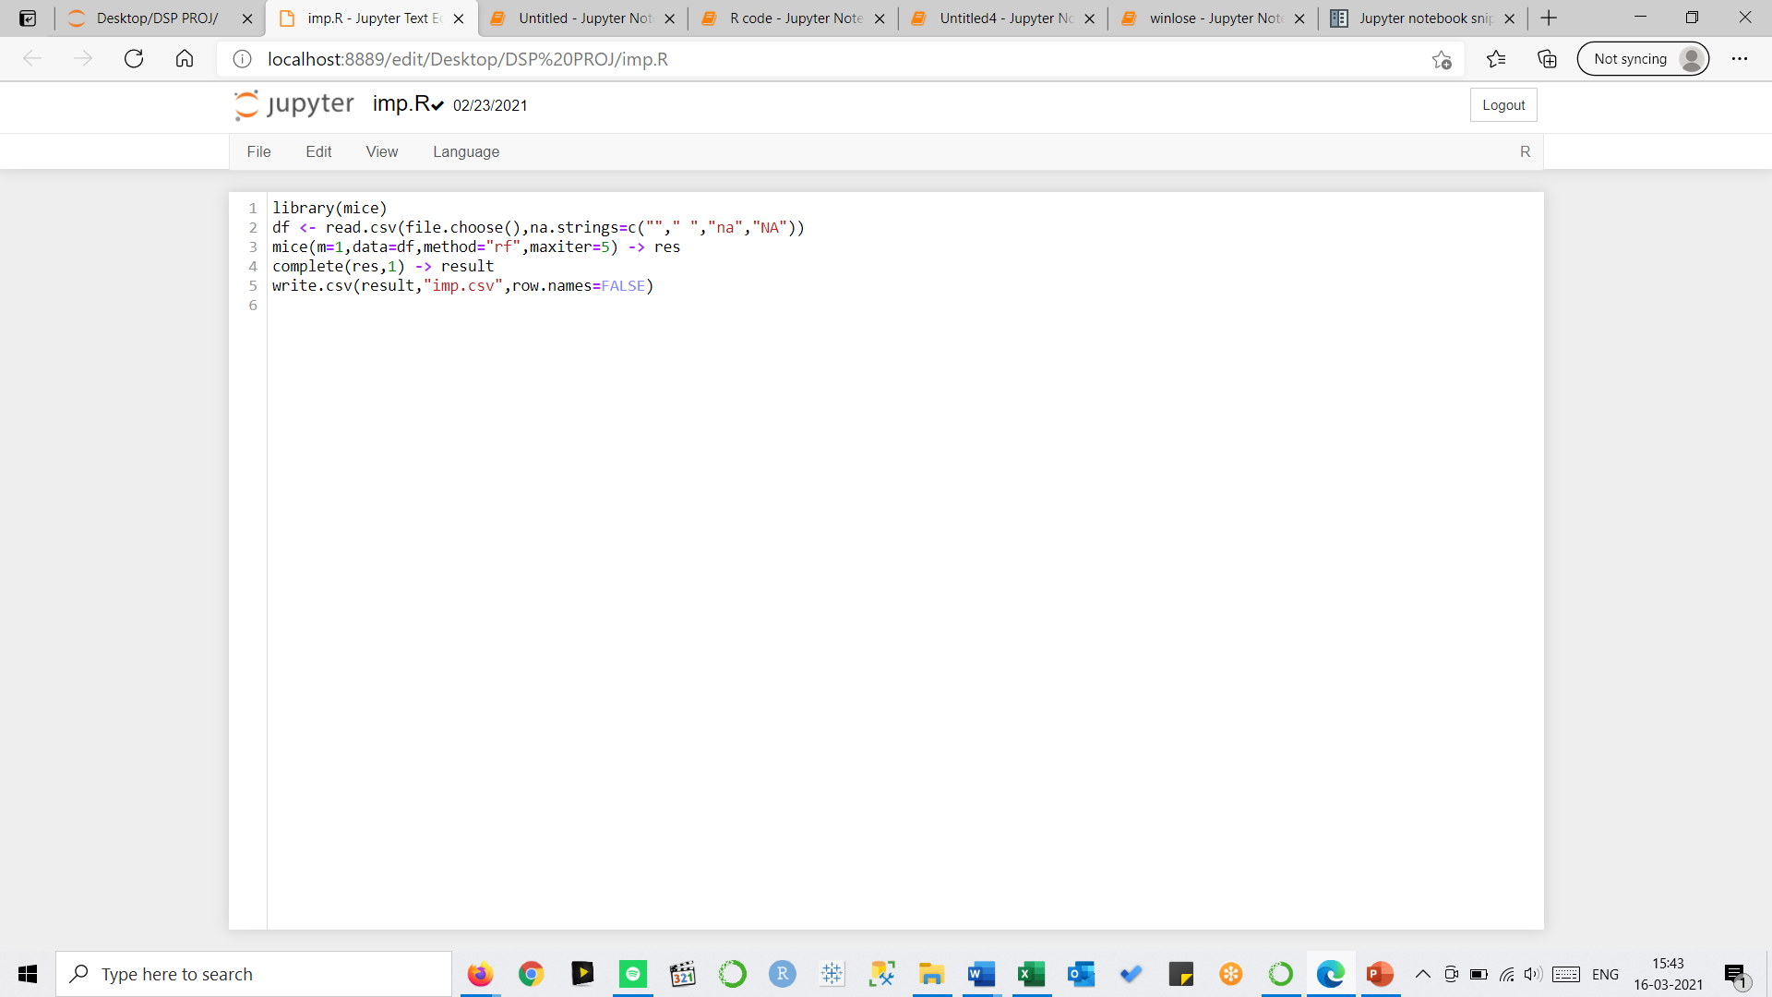
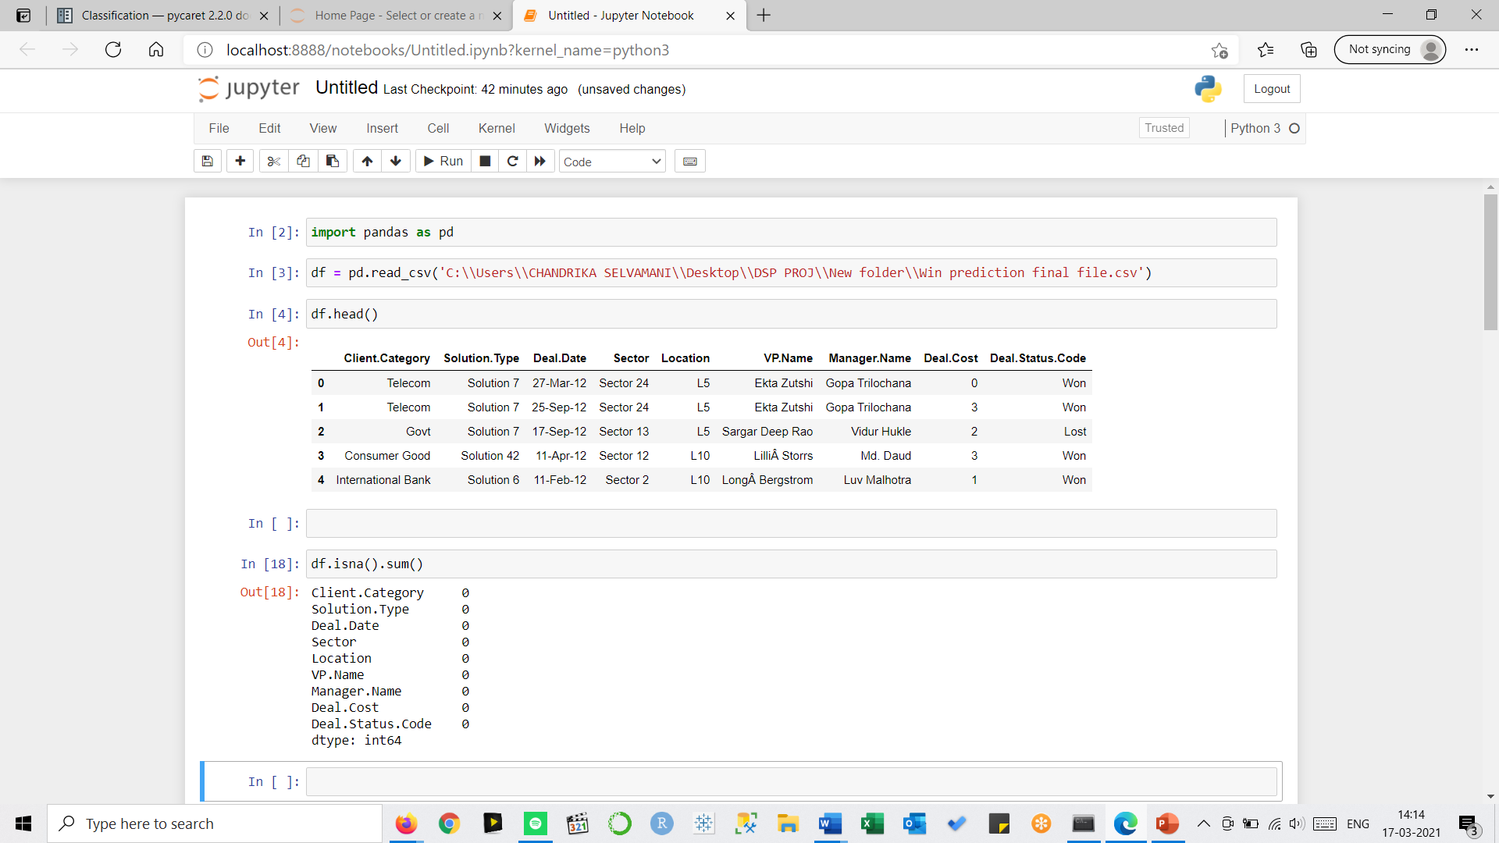
Imputation of missing values
The missing values in Client category and Deal cost are imputed using Mice imputation in R
MICE (Multivariate Imputation via Chained Equations) is one of the commonly used package by R users.
MICE assumes that the missing data are Missing at Random (MAR), which means that the probability that a value is missing depends only on observed value and can be predicted using them.
It imputes data on a variable by variable basis by specifying an imputation model per variable.
Creating multiple imputations as compared to a single imputation (such as mean) takes care of uncertainty in missing values.
The method used in ‘rf’ (Random forest)
As the random forest considers all the variables across for imputing the missing values, it is being used here

Slide 7
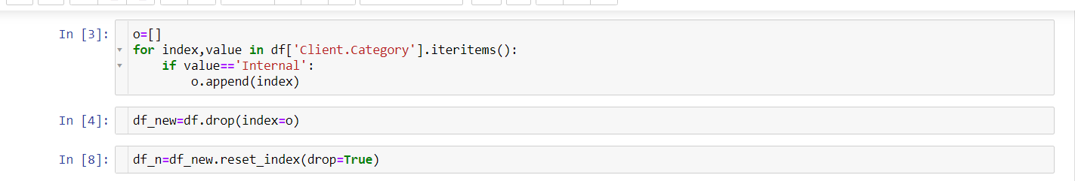
Checking for Outlier
The outlier in the data was found to be under the client category. “Internal” is a client category which is tagged for the projects within the organization. It was considered to not any value to the data.
Thus, It was dropped from the data in order to gain more accurate information and insights.

Slide 8
WIN PREDICTION – Prescriptive analysis
Insights based on the EDA
Visualization using tableau

Slide 9
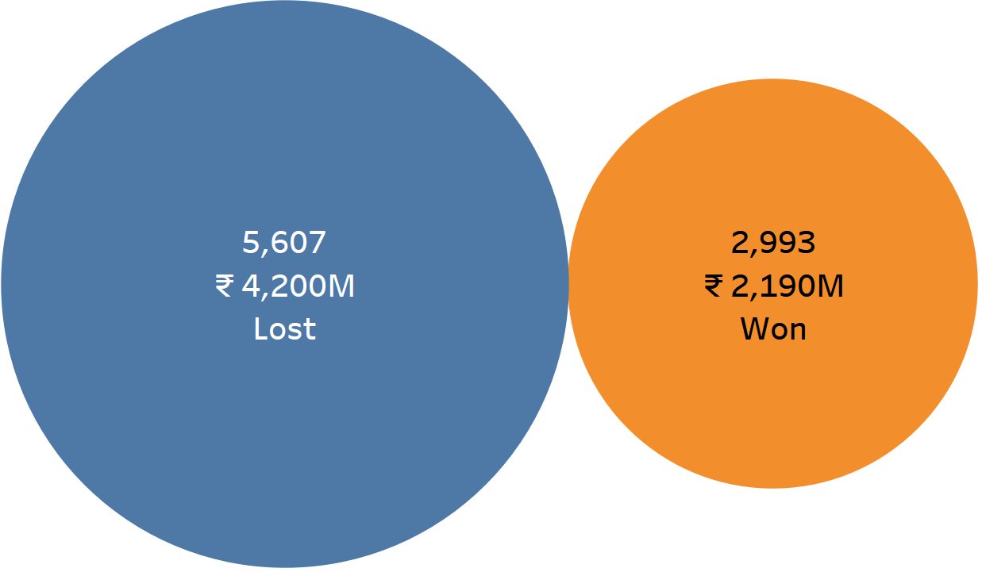
Insight on Response variable – Deal Status Code

Slide 10
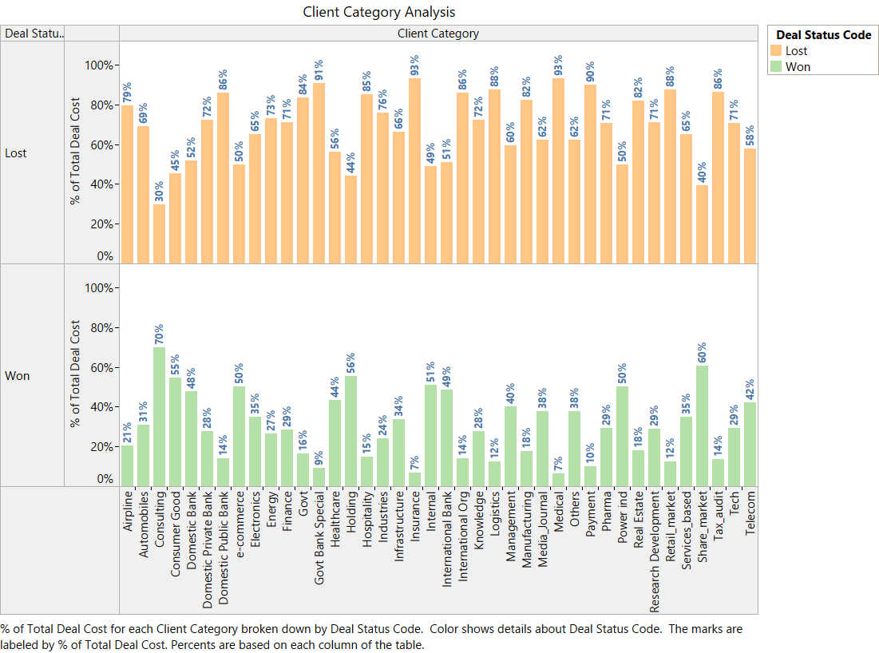
The highest performing Client Category is “Consulting” with a 70:30 Win Loss Ratio.
Total Deal cost – 371 M
Total No. of Projects- 346
Lowest performing sectors are “Insurance” and “medical” with very low Win Loss Ratio

Slide 11
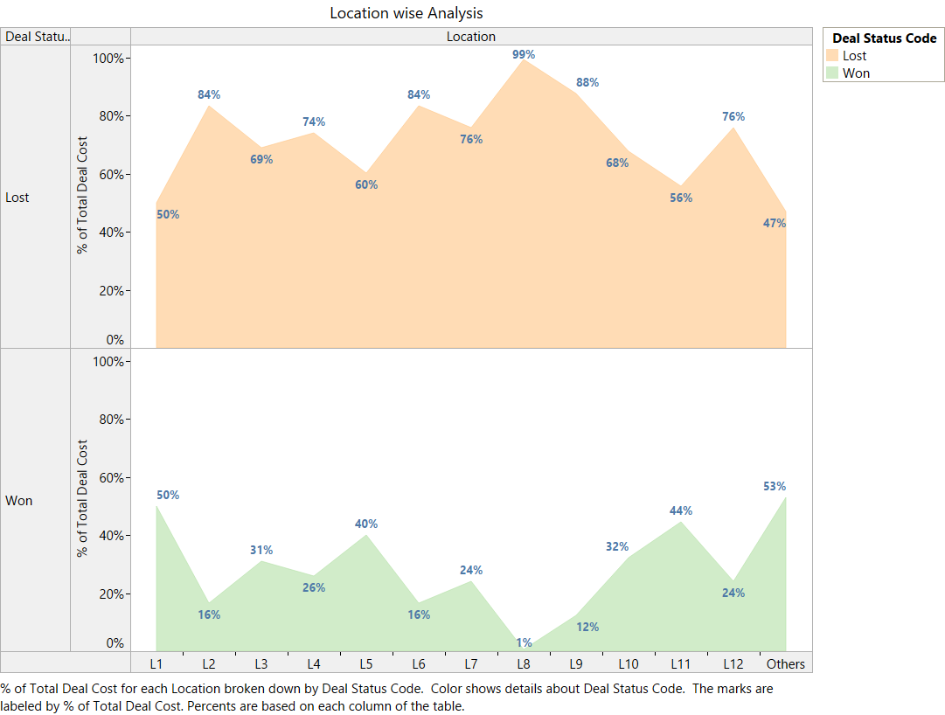
All locations are not performing with very low win loss ratio
‘other’ Location has a very marginal performance with 51:49 win ratio
Deal cost = 963 M
Total projects = 773

Slide 12
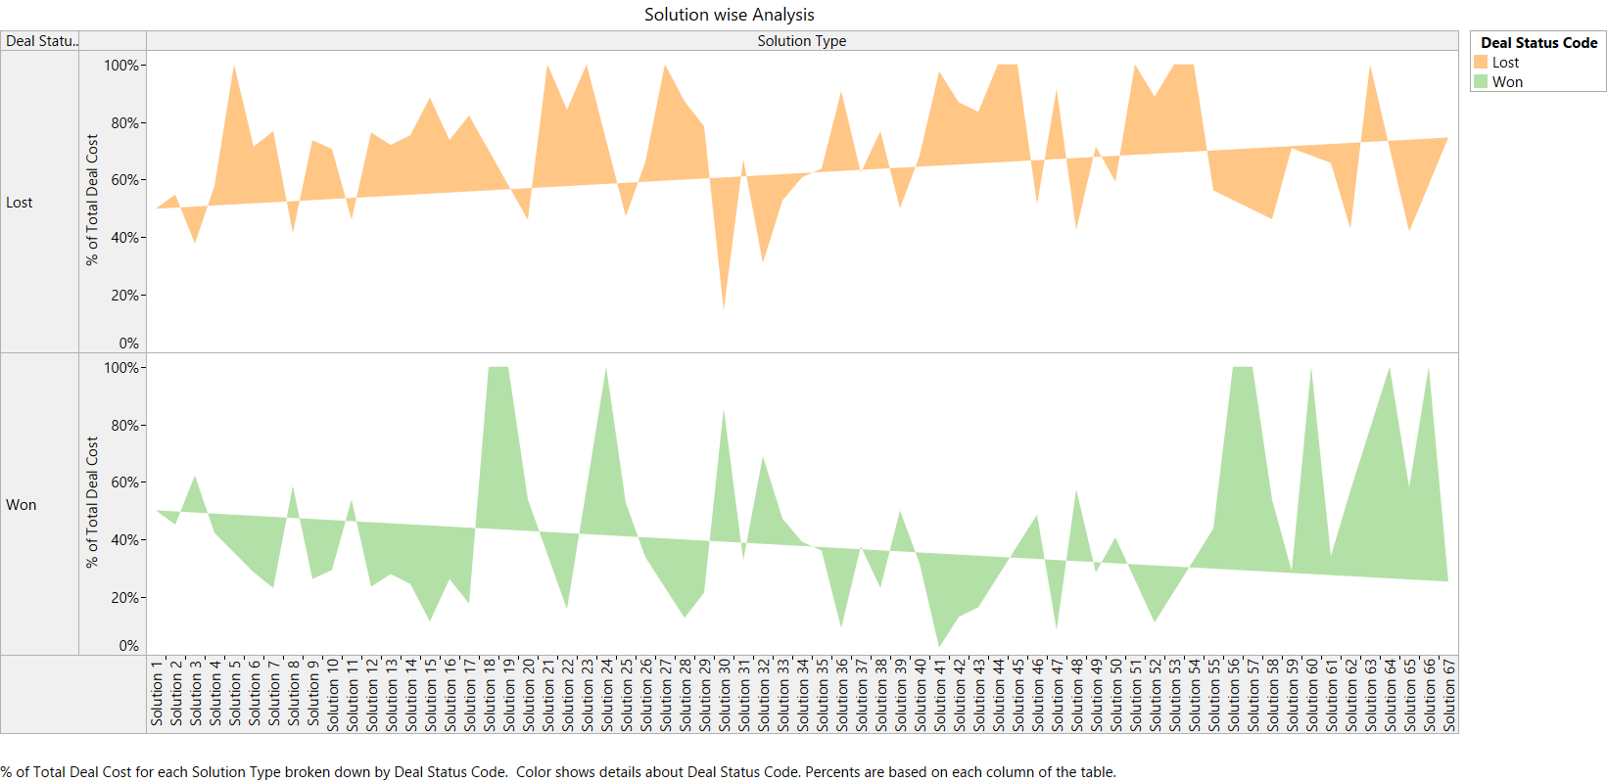
Solution wise the performance looks better as few solutions has performed 100%
Out of 67 solutions, NO. 18, 19 ,24, 56, 57, 60 64 ,66 have 100% performance

Slide 13
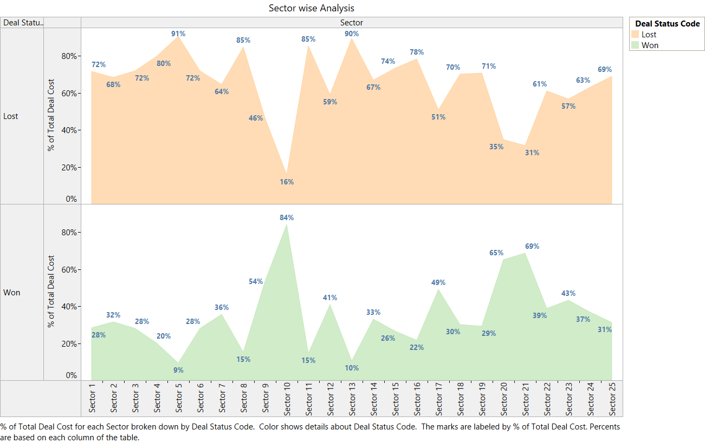
The highest performing sector is Sector 10 with a 84:16 Win Loss Ratio but the No. of projects is only 3
Highest projects are in sector 23 with 2631 projects and 30:60 win loss ratio
Lowest performing sectors are 5 and 13 with very low Win ratio.

Slide 14
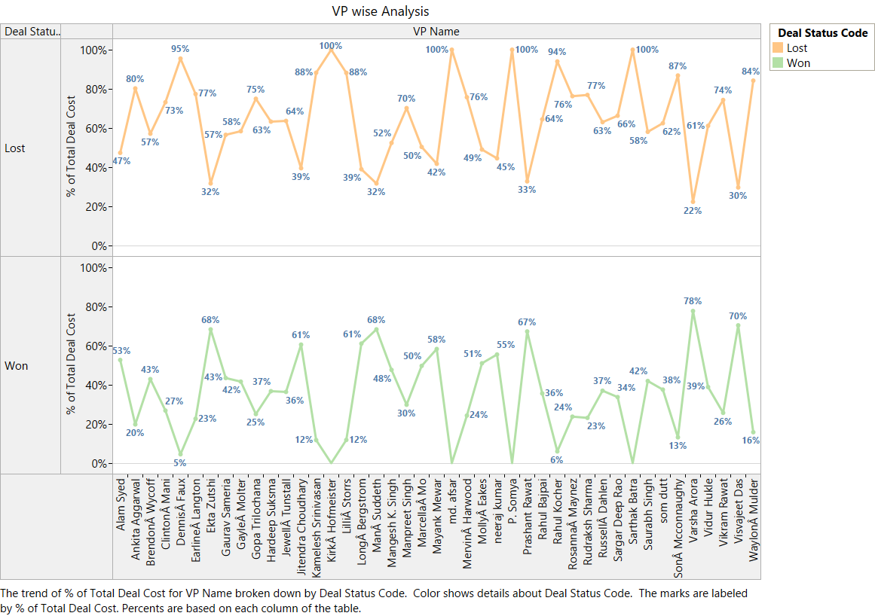
The highest performing VP is Varsha Arora with almost 80:20 winning ratio.
Total Project Value = 196 Mio
Total Project handed = 104
Lowest performers are Dennis and Rahul with very low Win ratio.
As per the total project value handled highest is Mervin
978 Mio with 30:70 win loss ratio

Slide 15
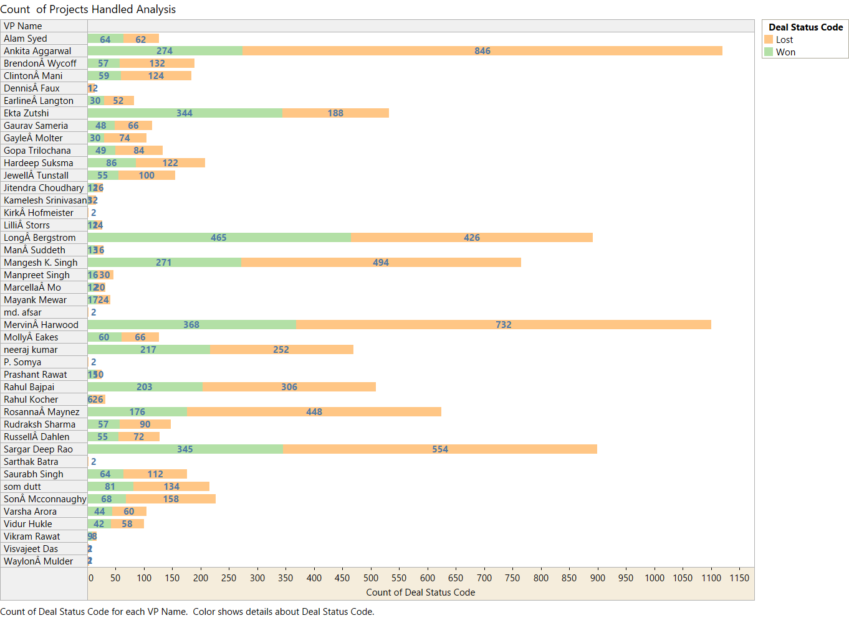
As per the count of projects the performance is not good across all VPs with high Loss instances.
Long Bergstrom has formed in a break even pattern.
Ankita has very high Loss instances. 30:70 Win Loss Ratio
Highest No. of Projects is handled by Ankita and Mervin 1120 and 1100 respectively closely followed by Sargar 899

Slide 16
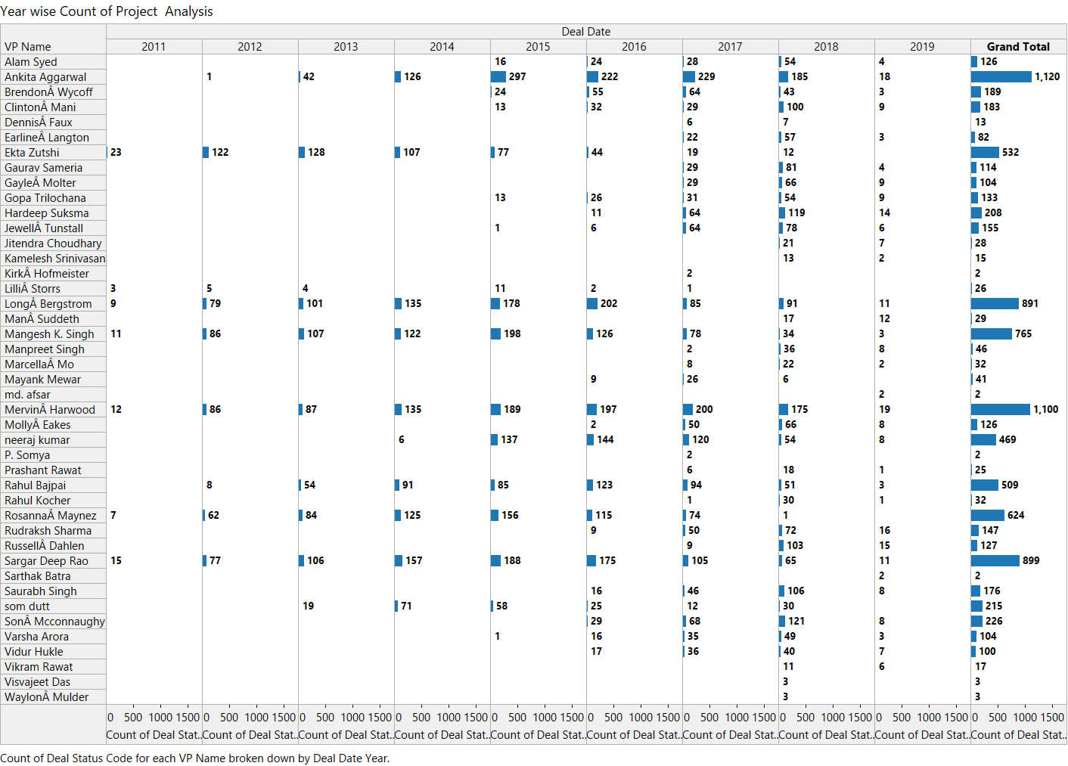
VP wise year wise analysis of the total projects handled.
There is no consistent performance by all VPs year wise based on the qty of projects handled.
7 VPs are seniors year wise.
Ekta
Lilli
Long
Mangesh
Mervin
Rosanna
Sargar
Ankita & Mervin have handled maximum number of projects.
Ankita Win Loss Ratio:24:76
Mervin Win Loss Ratio:33:67

Slide 17
Influencing factors considered when arriving at the best performing VP:
No. of years in the company.
No. of projects handled.
Value of the projects handled.
Win Loss Ratio.
Managers performance under each VP.
Performance under each independent variables influencing the response variable.

Slide 18
TOP PERFORMERS AMONG VP’s
VP name | Project handled from(Year) | Deal count |  |  |  |  | Deal cost(Mn) |  |  |  |  | Client category
 |  | Total count | Win count | Lost count | Win % | Lost % | Total cost | Win cost | Lost cost | Win % | Lost % | Client category | Count | Val (Mn)
Ekta Zutshi | 2011 | 481 | 283 | 198 | 59% | 41% | 492.40 | 314.56 | 177.84 | 64% | 36% | Others | 108 | 137.8
Alam syed | 2015 | 112 | 54 | 58 | 48% | 52% | 119.60 | 67.79 | 51.81 | 57% | 43% | Domestic bank | 14 | 44.5
Longa Bergstrom | 2011 | 796 | 372 | 424 | 47% | 53% | 469.44 | 275.24 | 194.20 | 59% | 41% | Others | 96 | 50.11
Neeraj kumar | 2014 | 393 | 164 | 229 | 42% | 58% | 224.71 | 114.22 | 110.49 | 51% | 49% | Tech | 42 | 27.13
Russella Dahlen | 2017 | 122 | 49 | 58 | 40% | 60% | 52.87 | 19.00 | 33.87 | 36% | 64% | Others | 10 | 3.41

Slide 19
TOP PERFORMERS AMONG VP’s (Contd…)
VP name
Ekta Zutshi
Alam syed
Longa Bergstrom
Neeraj kumar
Russella Dahlen
Sector |  |  | Location |  |  | Solution |  |  | Manager
Sector | Count | Val (Mn) | Location | Count | Val (Mn) | Solution | Count | Val (Mn) | Manager | Count | Val (Mn)
23 | 183 | 207.26 | L5 | 110 | 169.72 | 32 | 178 | 213.3 | Jeena Sappington | 35 | 13.88
16 | 17 | 29.22 | L1 | 26 | 39.35 | 4 | 31 | 33.91 | Darina vath | 17 | 13.14
23 | 155 | 99.56 | L10 | 231 | 212.99 | 32 | 218 | 204.01 | Russella Dahlen | 63 | 59.87
23 | 126 | 81.72 | L1 | 130 | 89.67 | 32 | 139 | 99.49 | Vinay kumar | 46 | 34.41
17 | 11 | 0.61 | L10 | 39 | 14.4 | 38 | 15 | 1.12 | Akshit Khanna | 12 | 5.87

Slide 20
Ekta Zutshi: (Strong points)
Handling projects since 2011
Appearing in high performers in the No. of Deals handled – 481
Appearing in high performers in the Deal Cost handled – 492 Mn
Ekta Zutshi is the most successful Vice president compared to others. She have performed with 59:41 win-loss ratio. Also she is the only Vp with a positive win ratio.
Client category , Location, sector and solution of Vp are based on with a high win ratio with respect to deal count.
Client category : Strong in others and consulting
Strong in L5 location
Strong in 23 Sectors
Strong in solution 32
Best Manager : Jeena Sappington

Slide 21
Alam syed: (Strong Points)
Handling projects since 2015
Appearing in high performers in the No. of Deals handled – 112
Appearing in high performers in the Deal Cost handled – 119 Mn
Alam syed performs at 48:52 win-loss ratio.
Client category , Location, Best manager, sector and solution of Vp are based on with a high win ratio with respect to deal count.
Client categories : Strong in Domestic bank , insurance and auto mobile
Strong in L1 location
Strong in Sector 16
Strong in solution 4
Best Manager: Darina vath

Slide 22
Longa Bergstrom:(strong points)
Handling projects since 2011
Appearing in high performers in the No. of Deals handled – 796
Appearing in high performers in the Deal Cost handled- 469 Mn
Longa Bergstrom performs at 47:53 win-loss ratio.
Client category , Location, sector, Best manager and solution of Vp are based on with a high win ratio with respect to deal count.
Client Category : Strong in others ,service based and international bank
Strong in L10 location
Strong in sector 23
Strong in solution 32
Best Manager: Russella Dahlen

Slide 23
Neeraj kumar:(strong points)
Handling projects since 2014
Appearing in high performers in the No. of Deals handled – 393
Appearing in high performers in the Deal Cost handled – 225 Mn
Neeraj kumar performs at 42:58 win-loss ratio.
Client category , Location, Best manager, sector and solution of Vp are based on with a high win ratio with respect to deal count.
Client Category - Strong in Tech, Service based and consulting
Strong in L1 location
Strong in Sector 23
Strong in solution 32
Best Manager: Vinay kumar

Slide 24
Russella Dahlen: (Strong points)
Handling projects since 2017
Appearing in high performers in the No. of Deals handled – 122
Appearing in high performers in the Deal Cost handled – 53 Mn
Russella Dahlen performs at 40:60 win-loss ratio.
Client category , Location, Best manager, sector and solution of Vp are based on with a high win ratio with respect to deal count.
Client categories : Strong in others, management, tech
Strong in L10 location
Strong in Sector 17
Strong in solution 38
Best Manager: Akshit Khanna

Slide 25
ADDITIONAL RECOMMENDATIONS – VP WISE
VP Name | Project handled from (year) | Deal count |  |  |  |  | Deal cost(Mn)
 |  | Total count | Win count | Lost count | Win % | Lost % | Total cost | Win cost | Lost cost | Win % | Lost %
Vikram Rawat | 2018 | 17 | 9 | 8 | 53.00% | 47.00% | 18 | 5 | 13 | 25% | 75%
Prashant Rawat | 2017 | 24 | 12 | 12 | 50% | 50% | 18 | 10 | 8 | 55% | 45%
Mana Suddeth | 2018 | 27 | 13 | 14 | 48% | 52% | 34 | 24 | 10 | 70% | 30%
Mayank Mewar | 2016 | 37 | 15 | 22 | 41% | 59% | 23 | 14 | 10 | 60% | 40%

Slide 26
Prescriptive analysis for loss faced by the company
VP name | Project handled from(Year) | Deal count |  |  |  |  | Deal cost(Mn)
 |  | Total count | Win count | Lost count | Win % | Lost % | Total cost | Win cost | Lost cost | Win % | t %
Sona Mcconnaughy | 2016 | 227 | 66 | 161 | 29% | 71% | 228 | 35 | 192 | 15% | 85%
Ankita Aggarwal | 2012 | 794 | 177 | 617 | 22% | 78% | 405 | 77 | 329 | 19% | 81%
Rosannaa Maynez | 2011 | 565 | 143 | 422 | 25% | 75% | 369 | 77 | 292 | 21% | 79%
Mervina Harwood | 2011 | 1107 | 339 | 768 | 31% | 69% | 1013 | 220 | 794 | 22% | 78%
Rahul Bajpai | 2012 | 498 | 180 | 318 | 36% | 64% | 295 | 89 | 206 | 30% | 70%
Mangesh K. Singh | 2011 | 608 | 167 | 441 | 27% | 73% | 438 | 134 | 304 | 31% | 69%
Sargar Deep Rao | 2011 | 846 | 298 | 548 | 35% | 65% | 540 | 172 | 368 | 32% | 68%

Slide 27
Total project deal cost of the data is 6390 Mn . Nearly 4200 Mn is a loss to the company
Out of total loss , 2485 Mn was loss incurred by these 7 VP’s out of 42 VP’s on total.
The cumulative loss of Sona Mcconnaughy, Ankita Aggarwal, Rosannaa Maynez,Mervina Harwood,Rahul Bajpai ,Mangesh K. Singh, Sargar Deep Rao is nearly 59% to the overall loss.

Slide 28
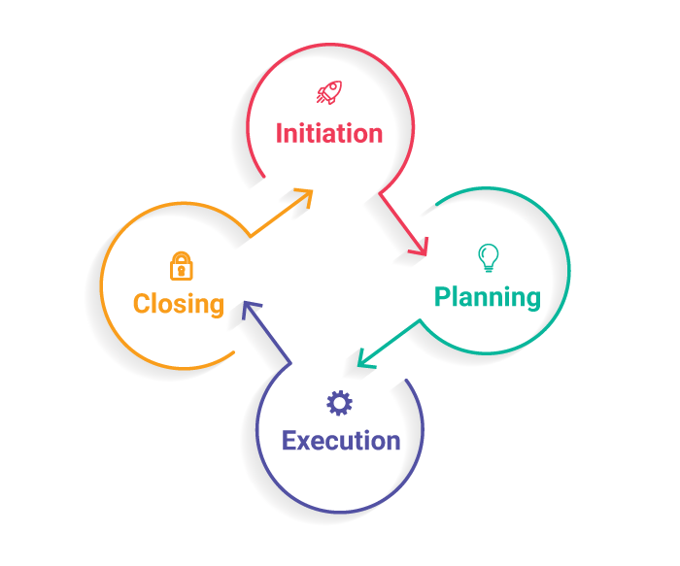
Phase of Project management :

Slide 29

Important qualities for a successful project management

Slide 30
THANKYOU

